Slide 2
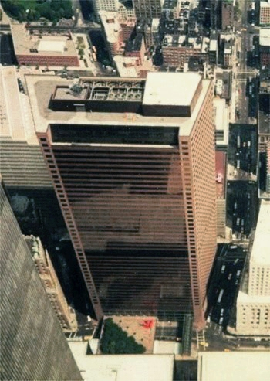
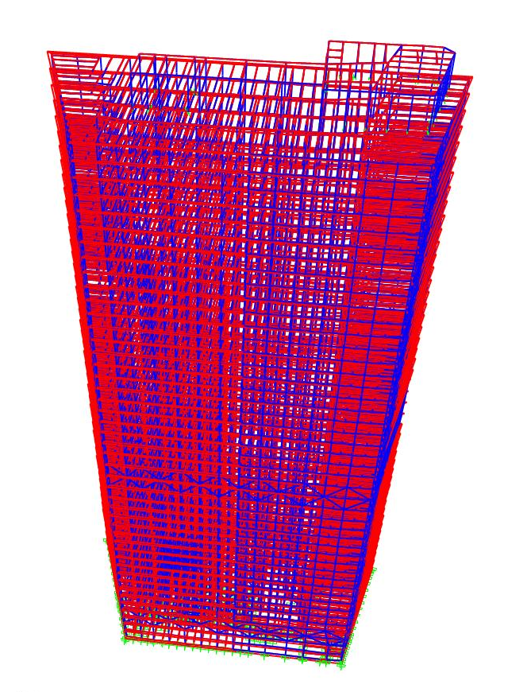
WTC7 vs Model [1]

Slide 3
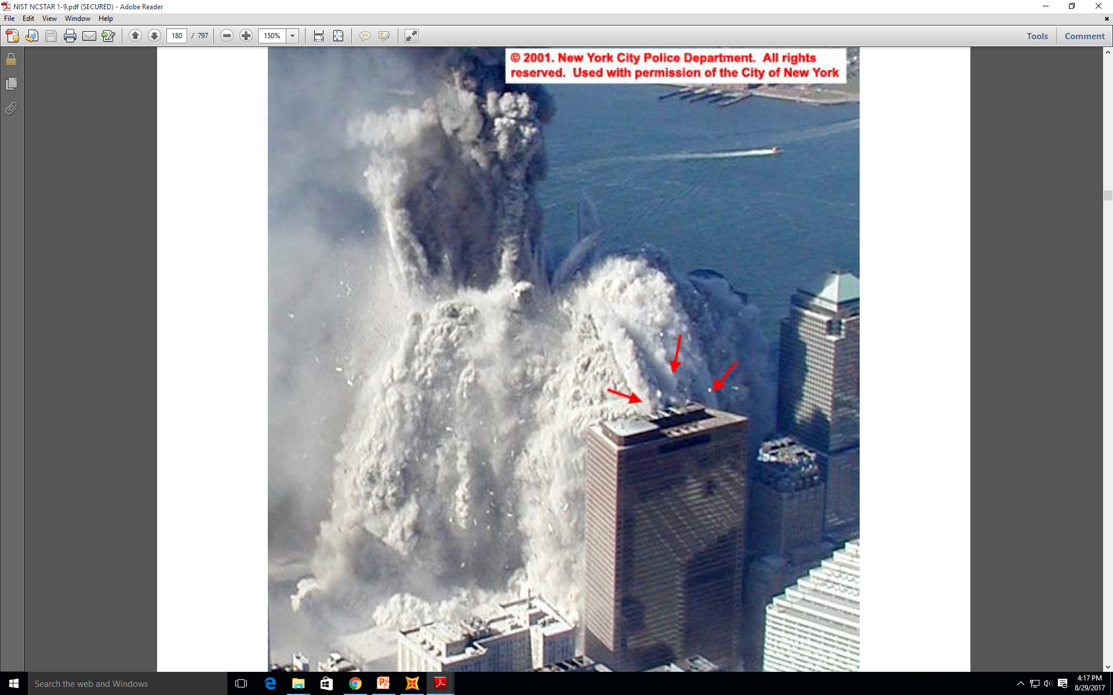
WTC1 Debris Hitting WTC7 [2]

Slide 4
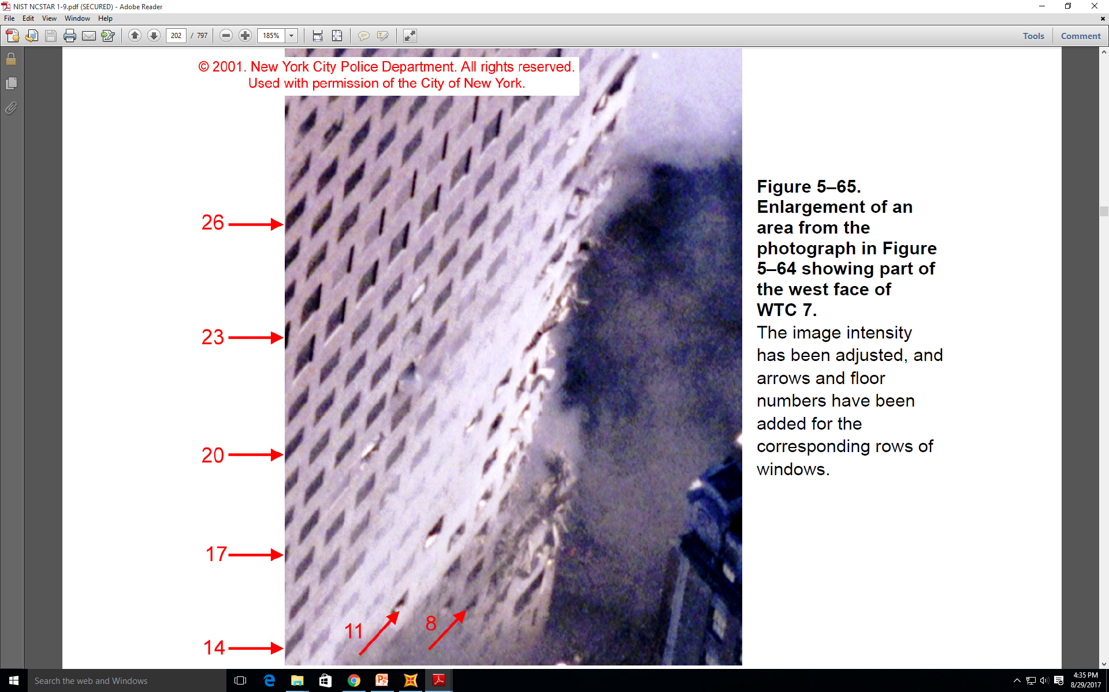
Visual Damage of WTC7 after the Impact of WTC1 [2]

Slide 5
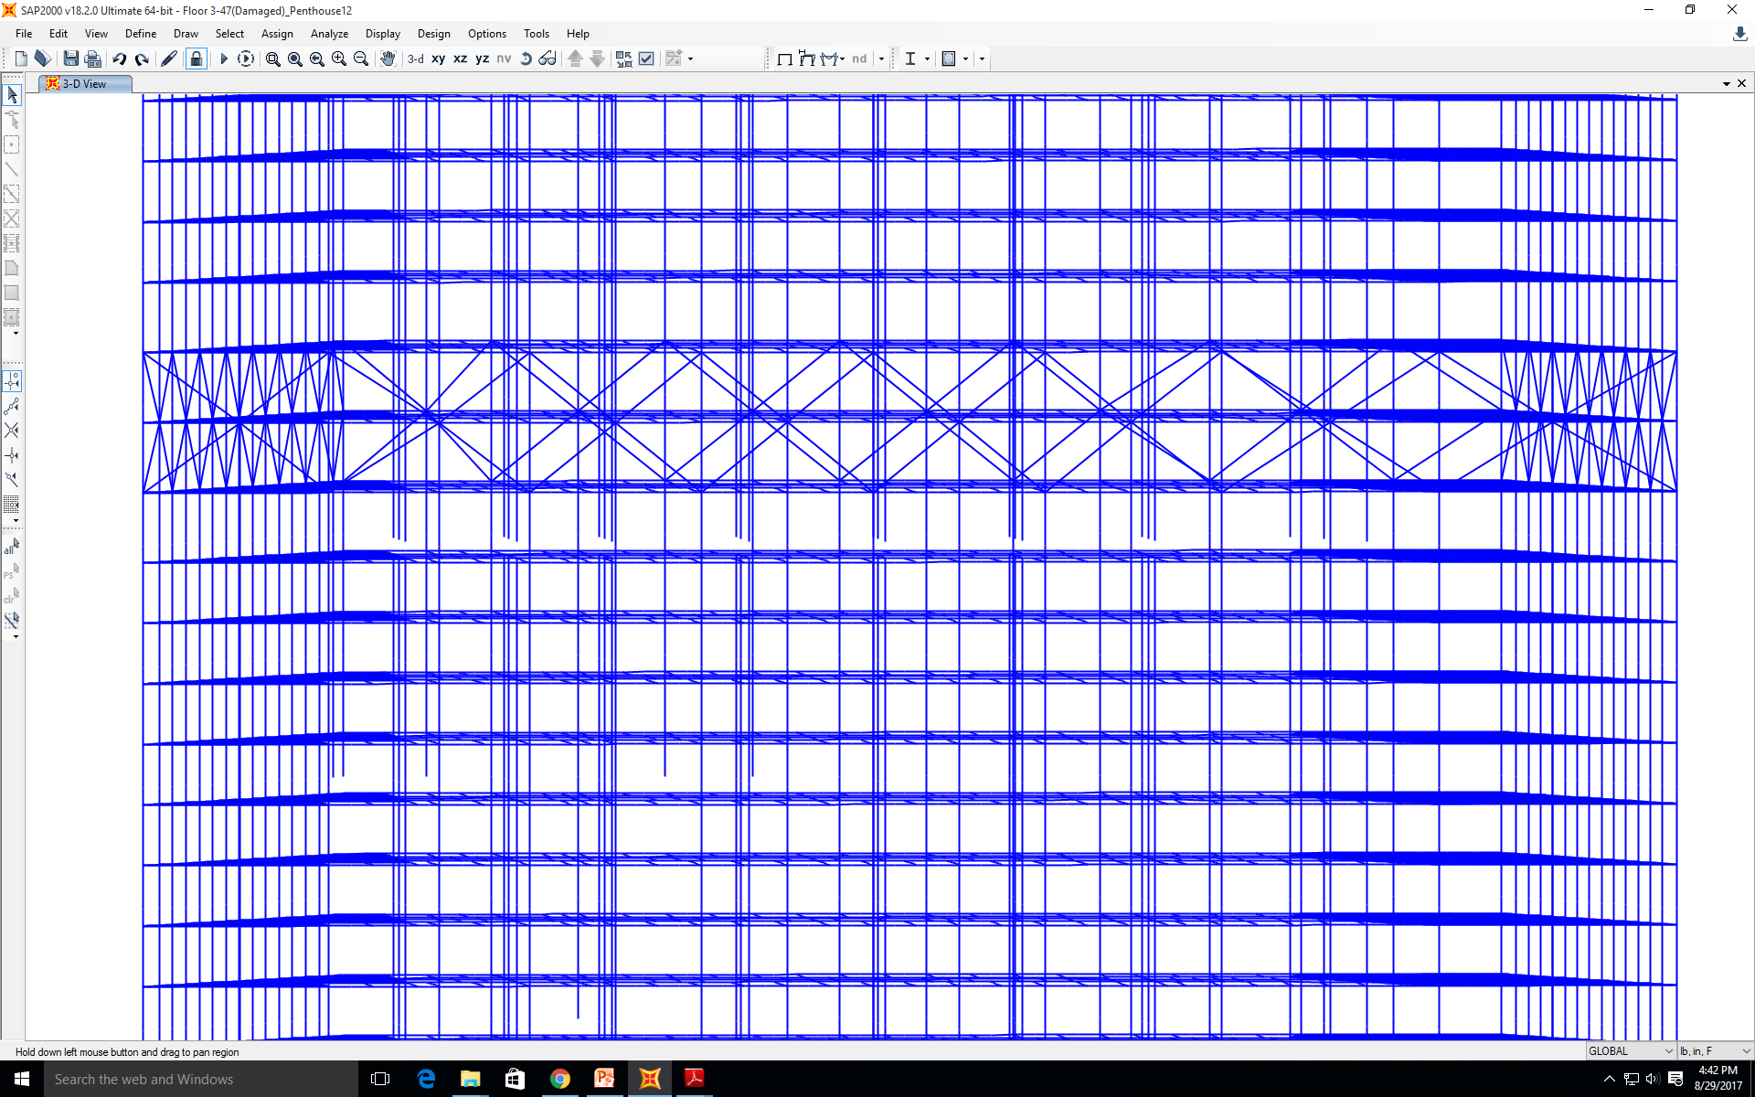
WTC7 Model with Damage

Slide 6
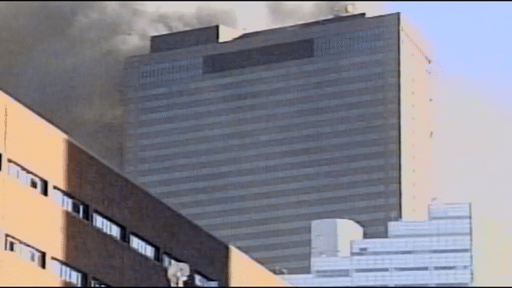
Video Footage of WTC7 Collapsing [3]

Slide 7
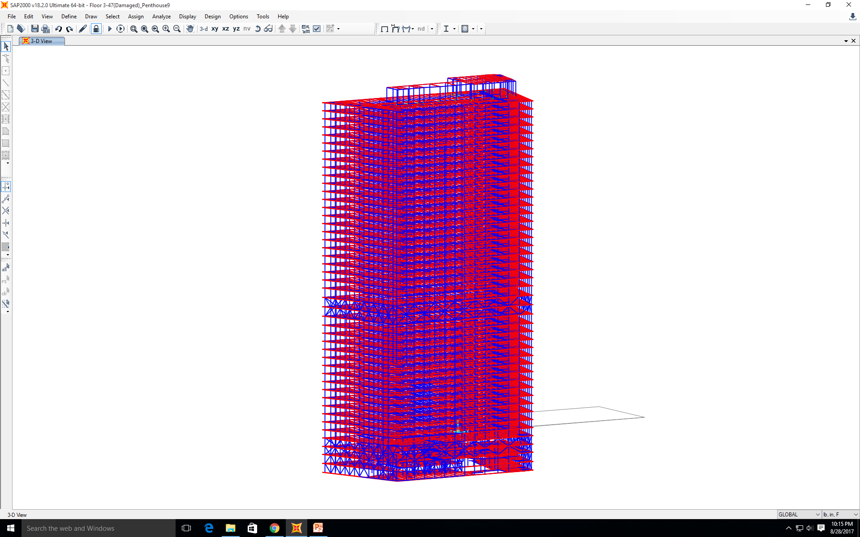
WTC7 Model (with Penthouse on Top) in another Perspective

Slide 8
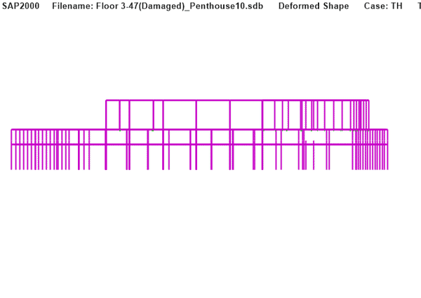
Penthouse Collapse (video)

Slide 9
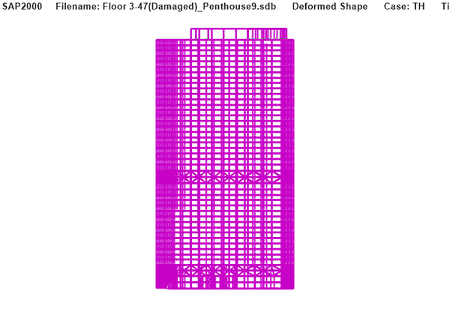
Whole Building Collapse (video)

Slide 10
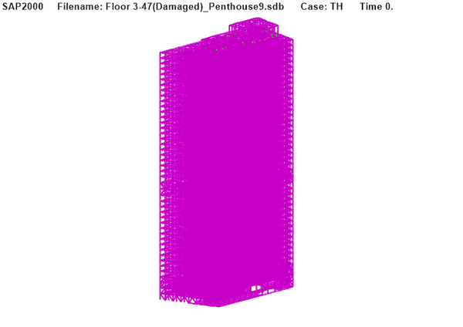
Whole Building collapse (different angle, video)

Slide 11
Put little headings and summary to explain what we did and the purpose of the analysis
Explain boundary condition as well and our findings
Explain the nature of the analysis(non/linear), element types

Slide 12
Model9: nonlinear; side plate on; 3 supports on;
Model10: nonlinear; side plate on; 3 supports off;
Model16: linear; side plate off; 3 supports on.

Slide 13
Model9: nonlinear analysis, geometrically and material-wise; side plate on; 3 supports on;
The diagrams show the stress distribution contour; displacement distribution contour; they also show that even if the bolts were sheared off, A2001 would get stuck behind side of column 79. They also show that if 3 lateral supports were on, G3005 would not buckle.

Slide 14
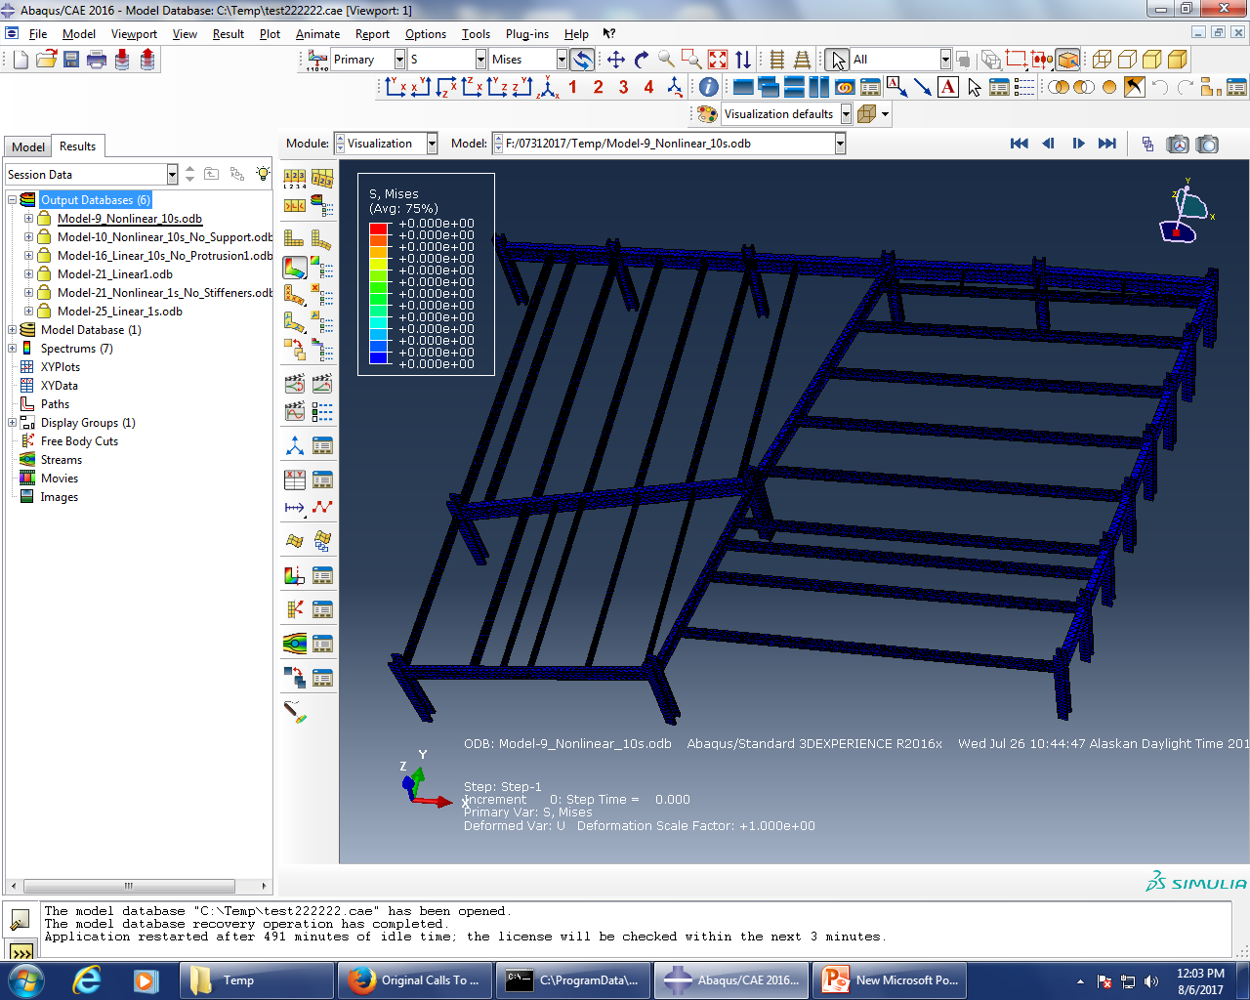
Model9: nonlinear; side plate on; 3 supports on;

Slide 15
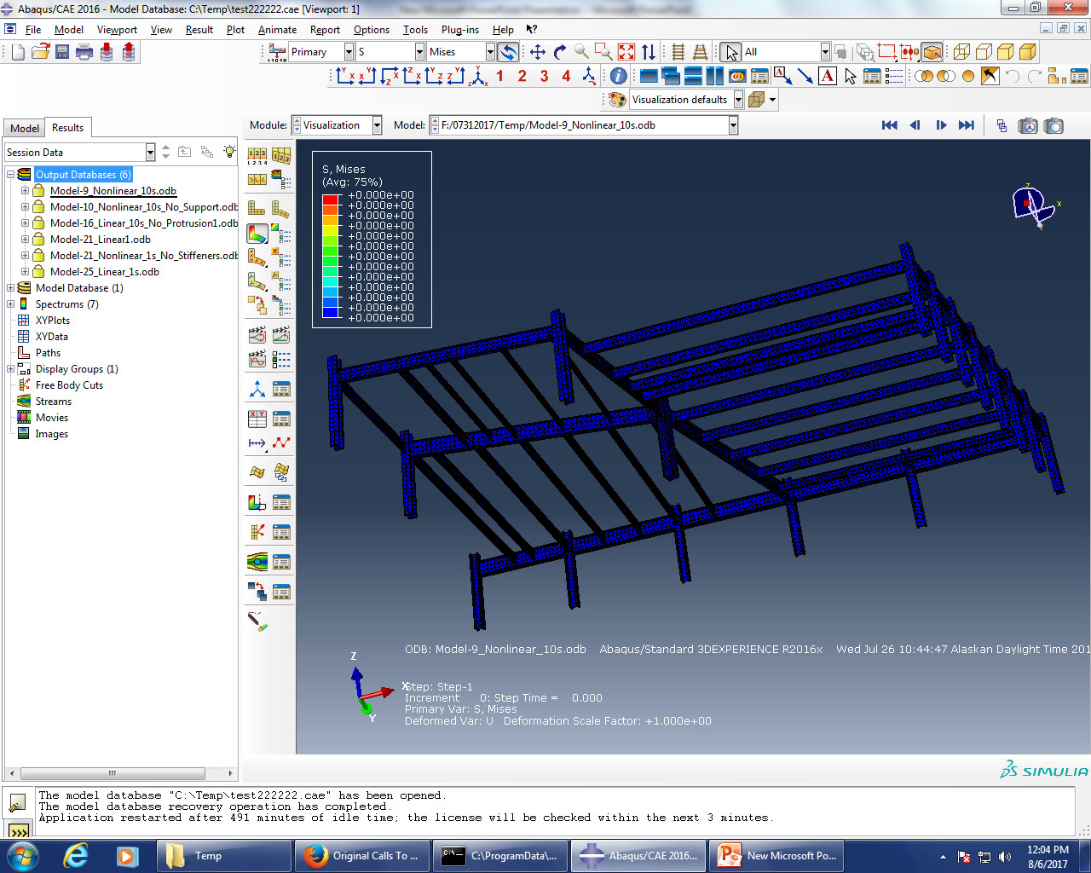

Slide 16
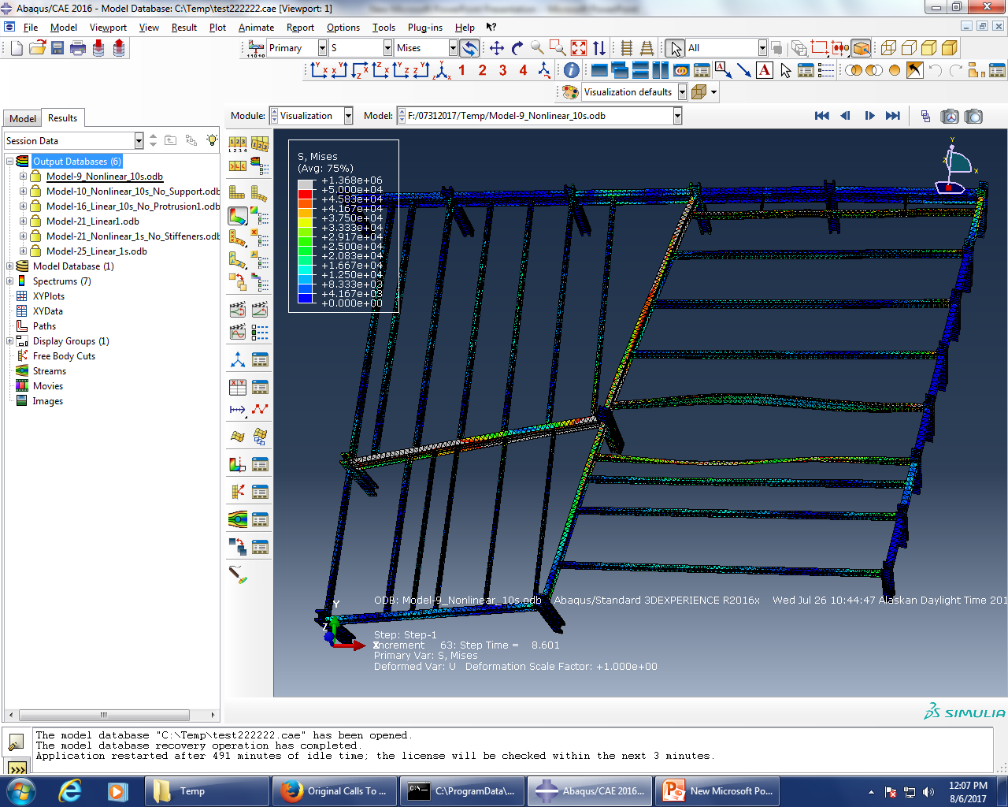

Slide 17
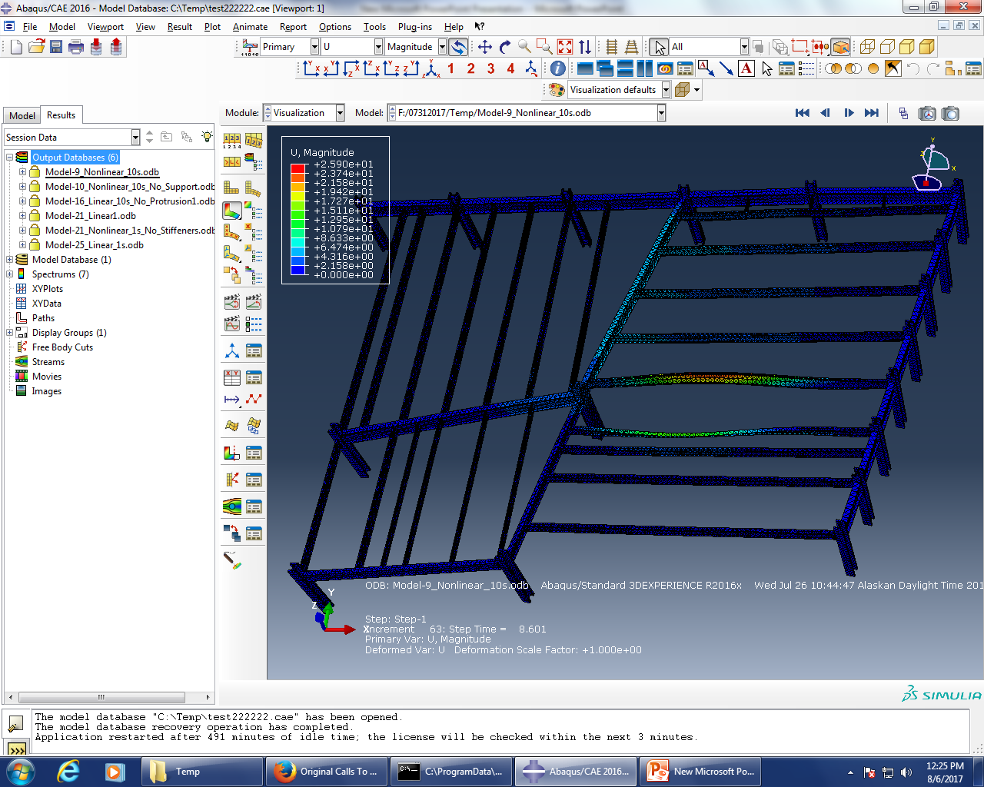

Slide 18
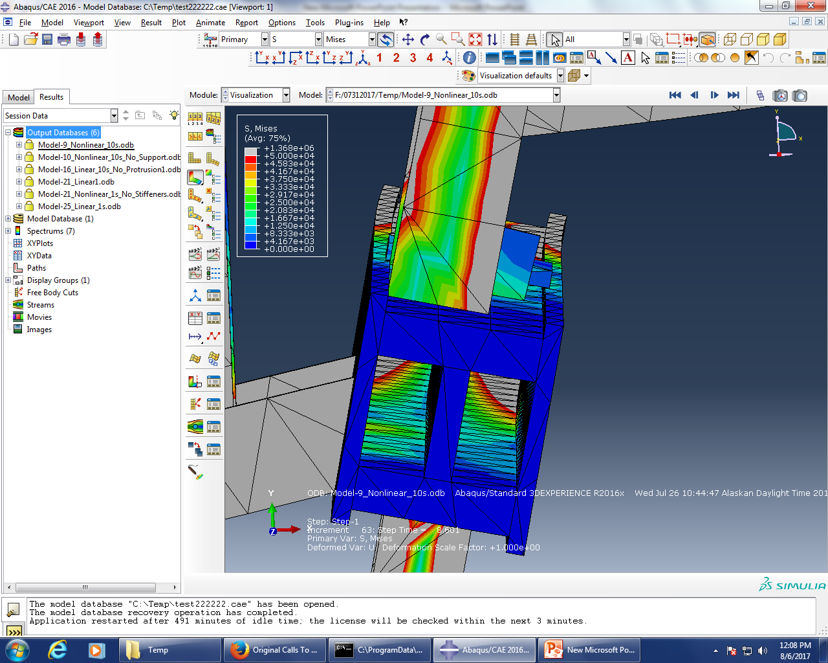

Slide 19
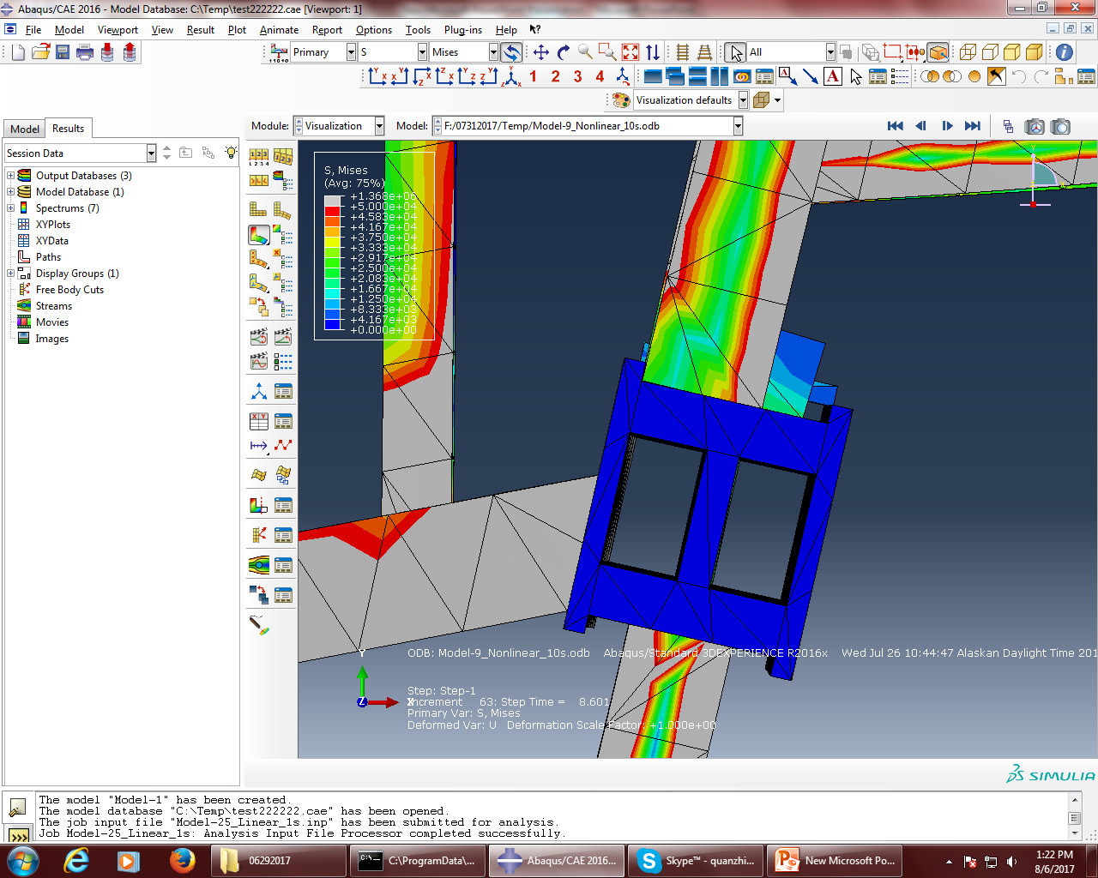

Slide 20
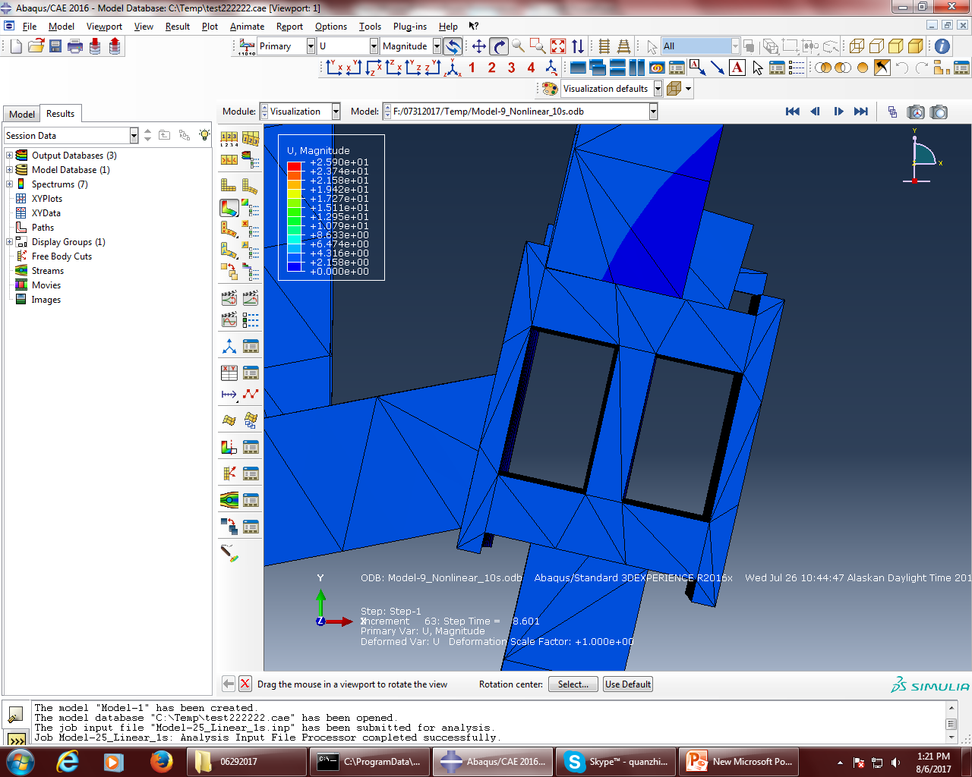

Slide 21
Model10: nonlinear analysis, geometrically and material-wise; side plate on; 3 supports off;
The diagrams show the stress distribution contour; displacement distribution contour; they also show that even if the bolts were sheared off, A2001 would get stuck behind side of column 79. They also show that if 3 lateral supports were off, G3005 would buckle.

Slide 22


Slide 23
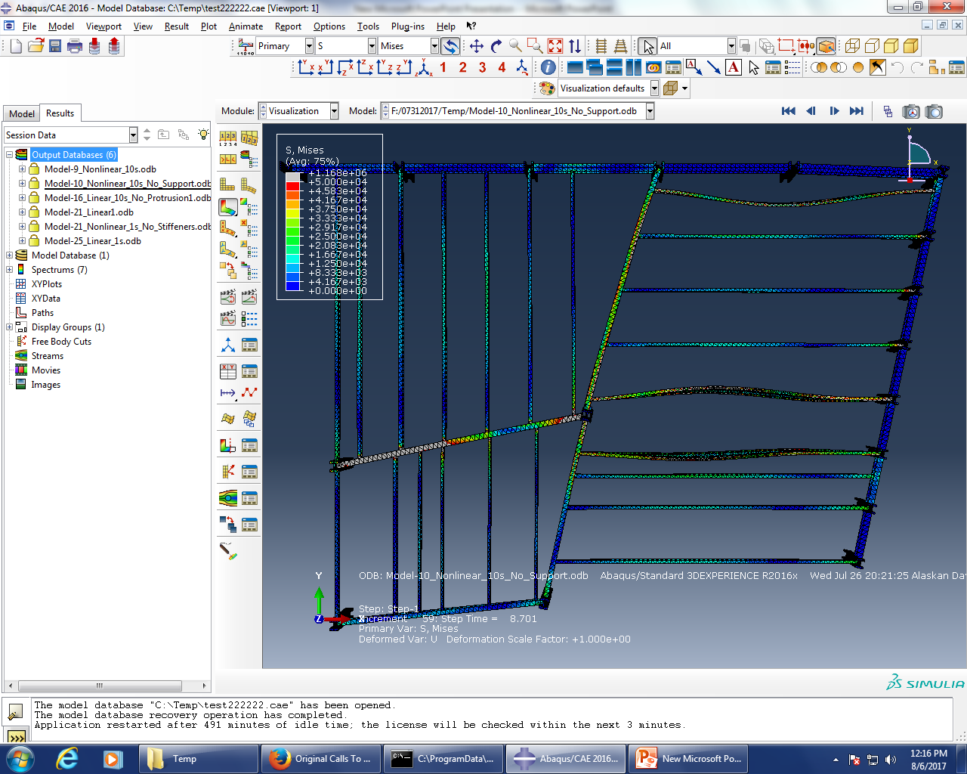

Slide 24
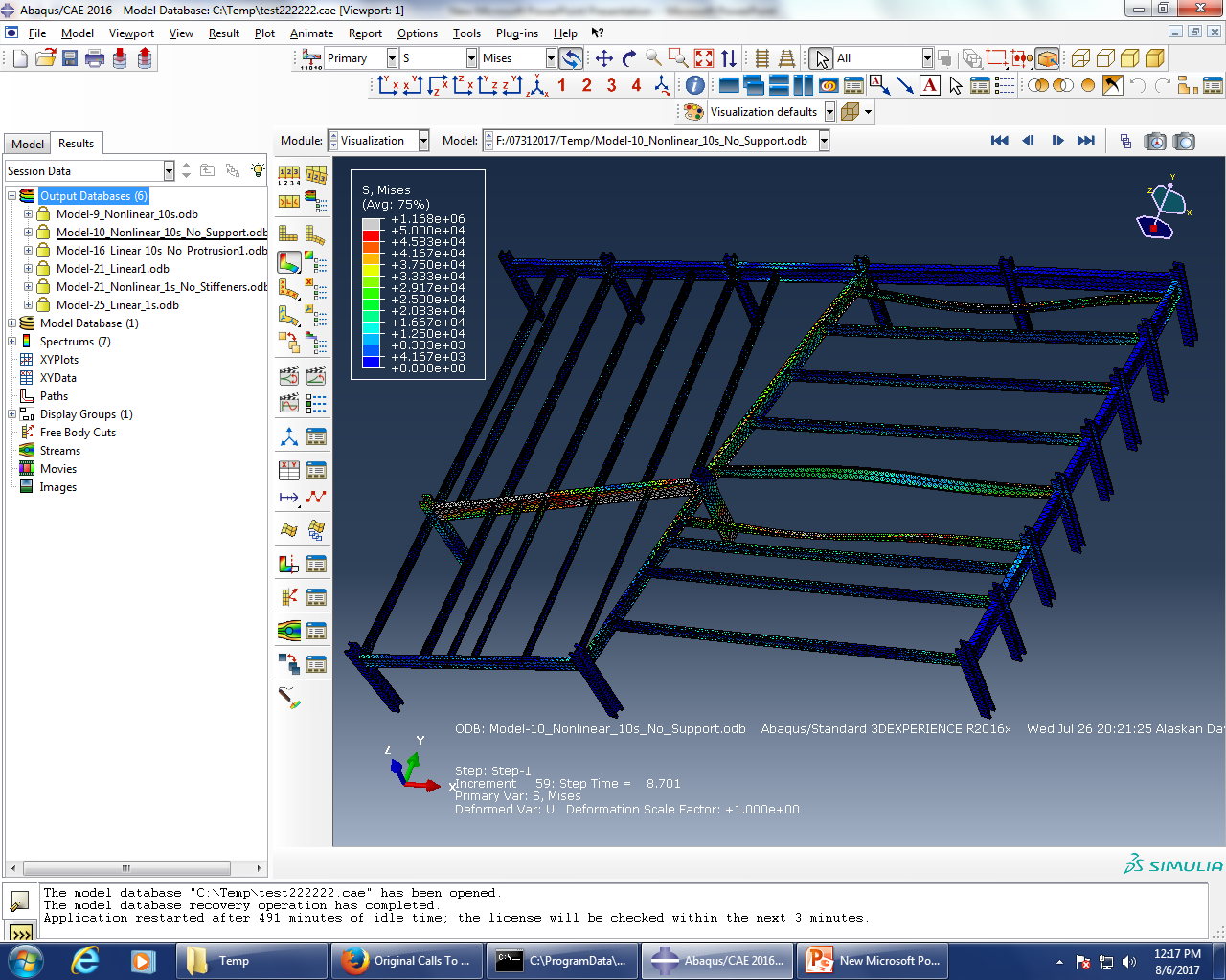

Slide 25
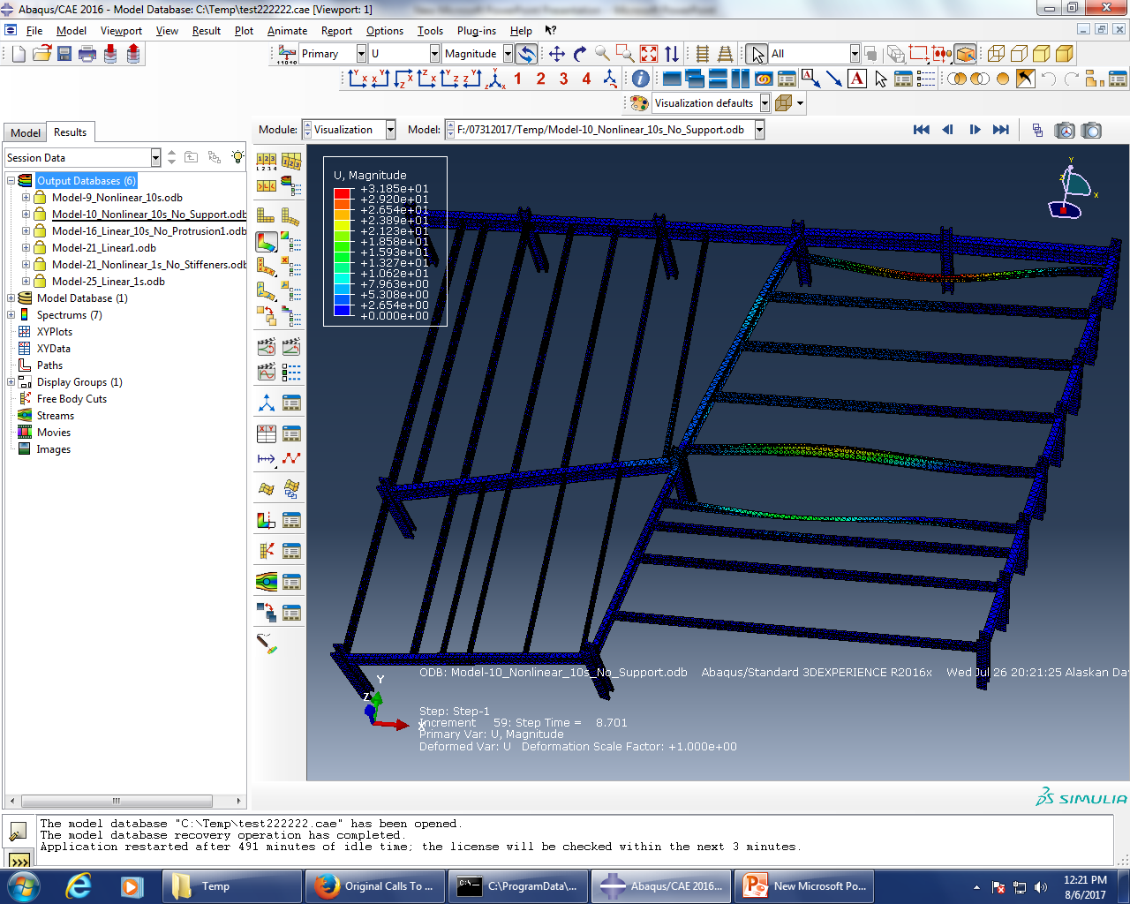

Slide 26
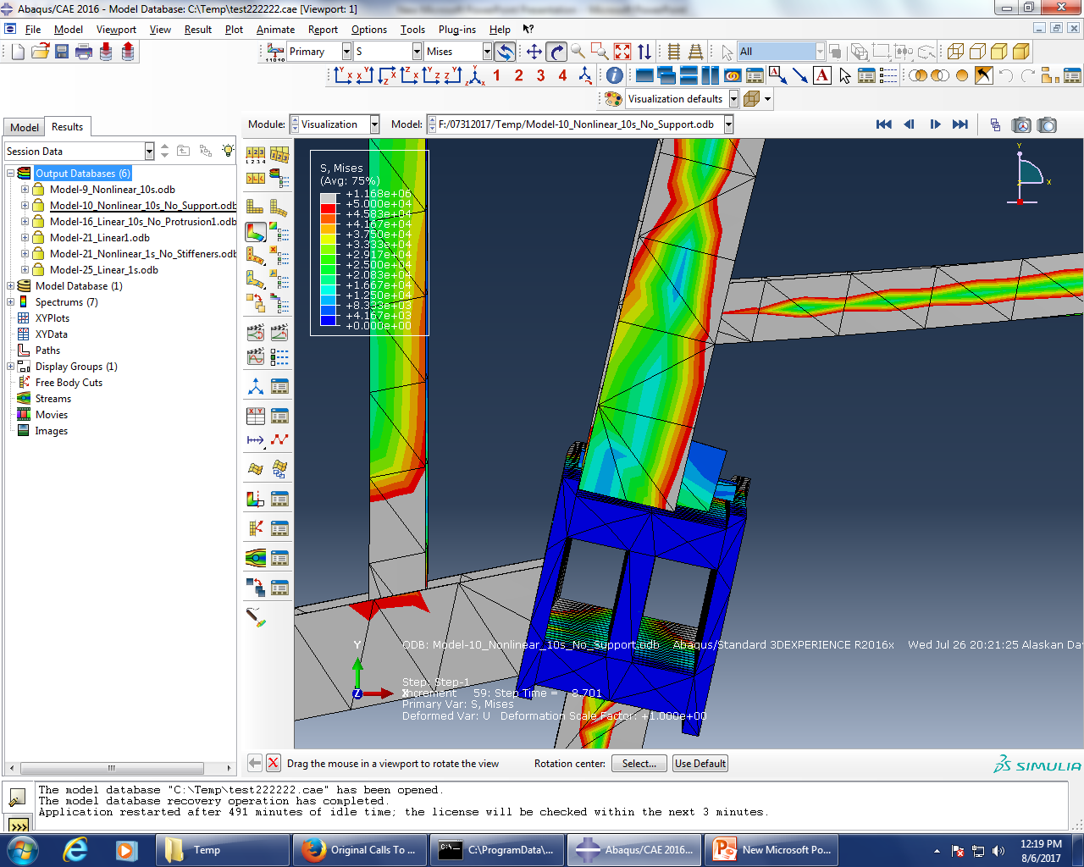

Slide 27
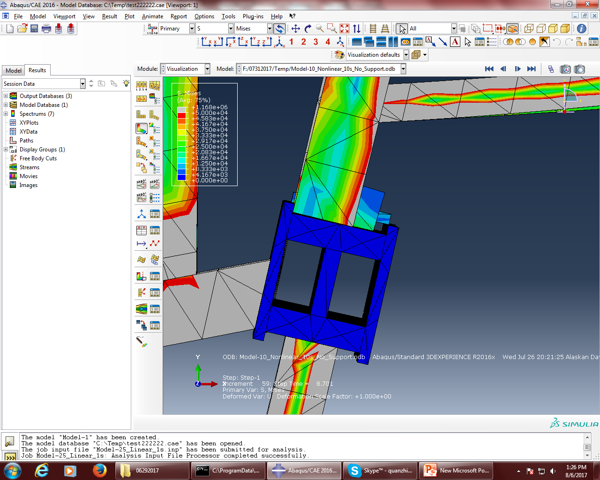

Slide 28
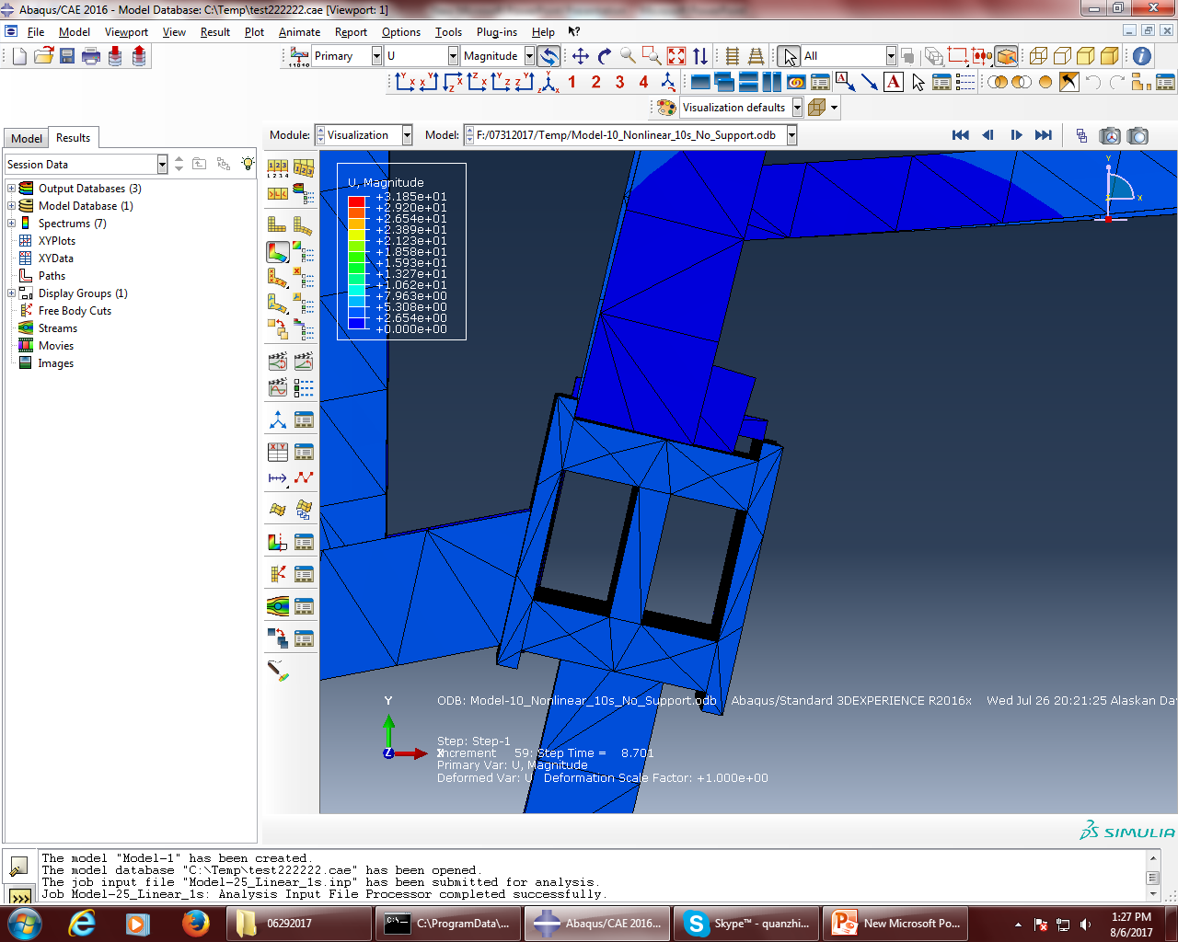

Slide 29
Model16: linear analysis; side plate off; 3 supports on;
The diagrams show the stress distribution contour; displacement distribution contour; they also show that the bolts were sheared off and the side plate of column 79 were off as well, A2001 would not travel far enough to be off the seat.

Slide 30
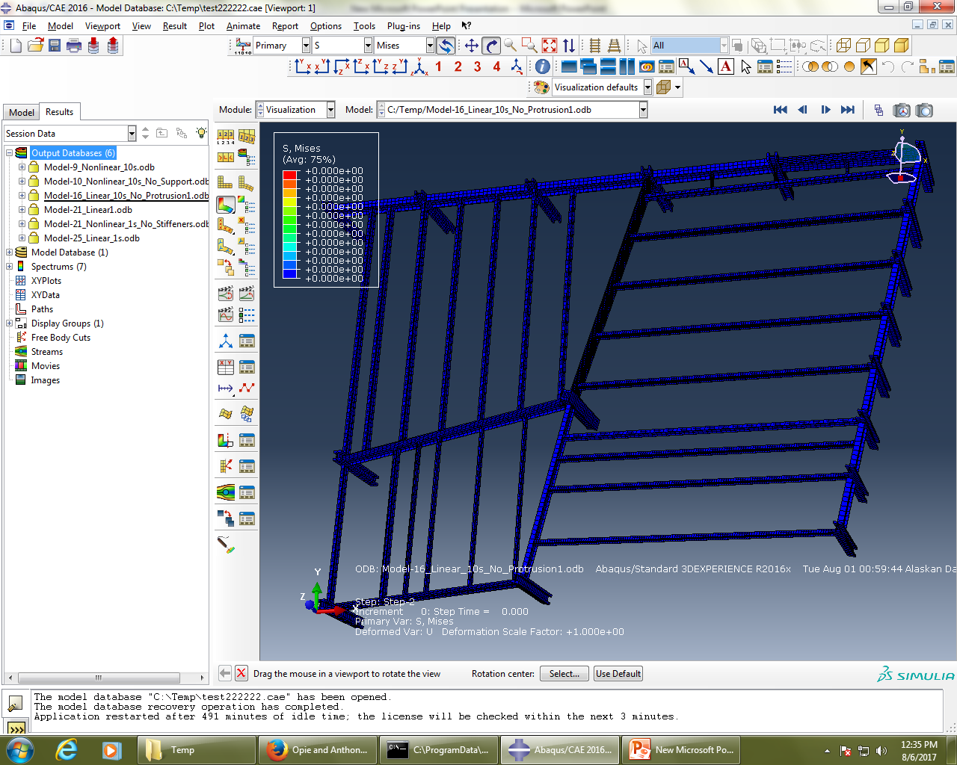

Slide 31
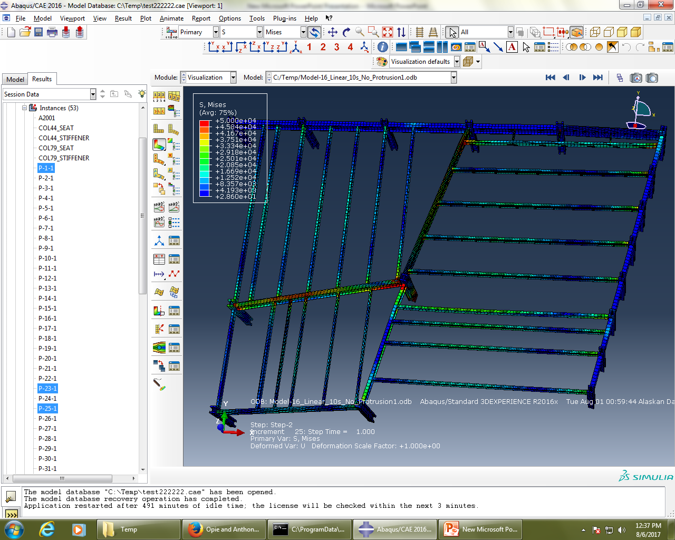

Slide 32
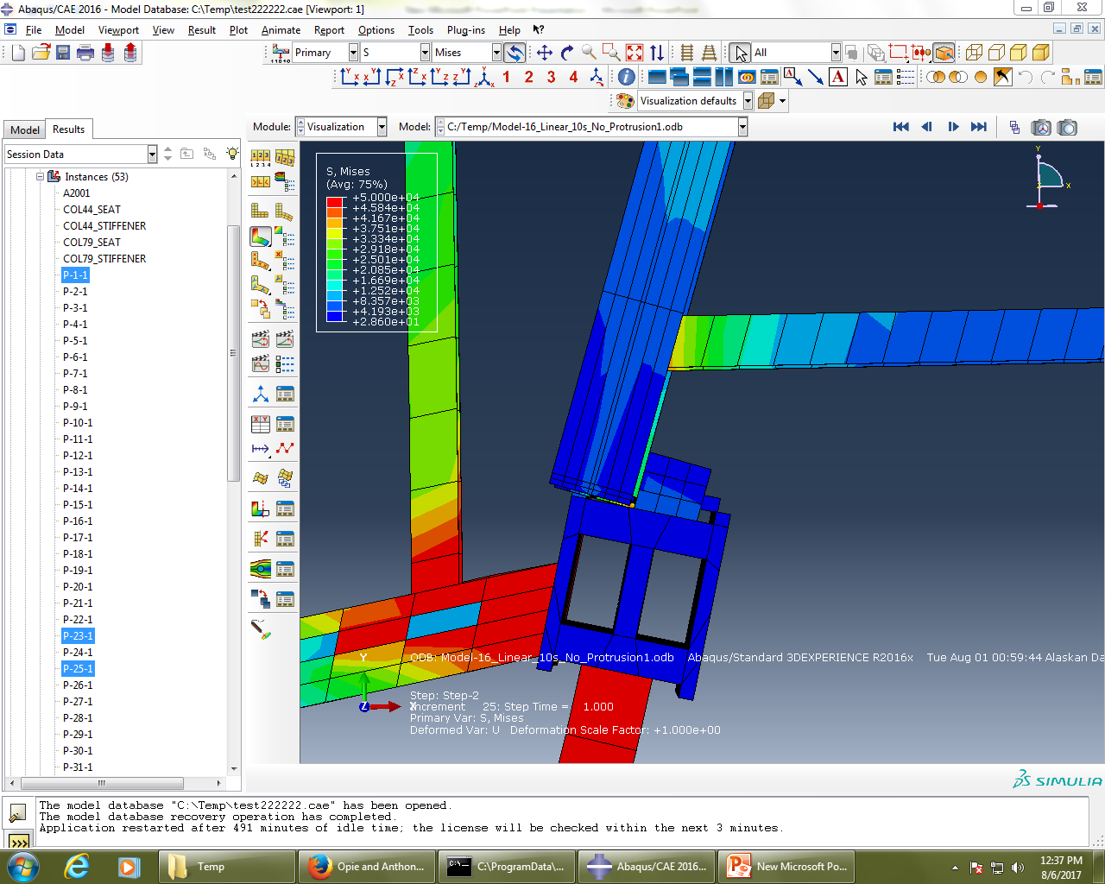

Slide 33
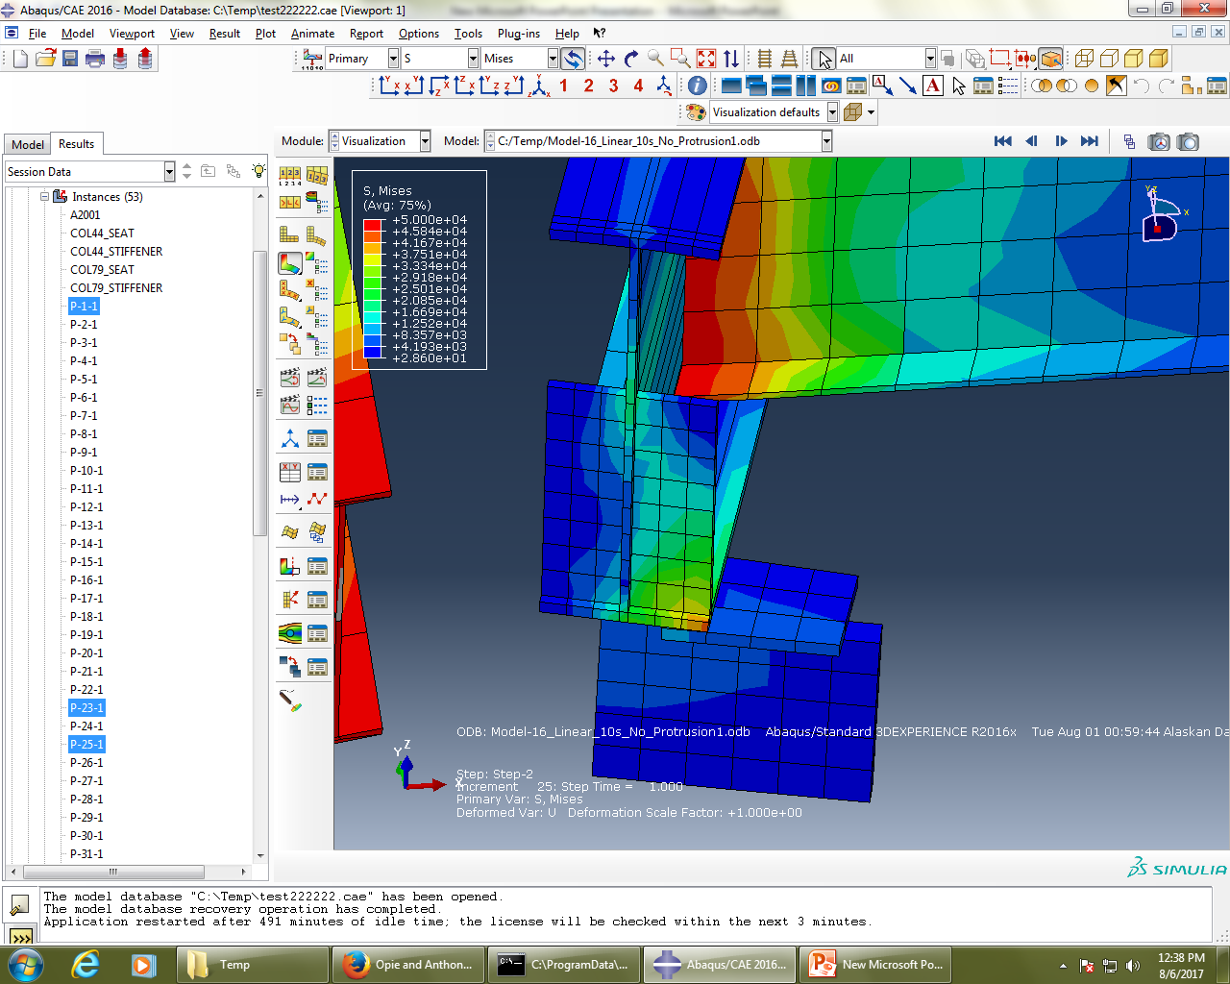

Slide 34
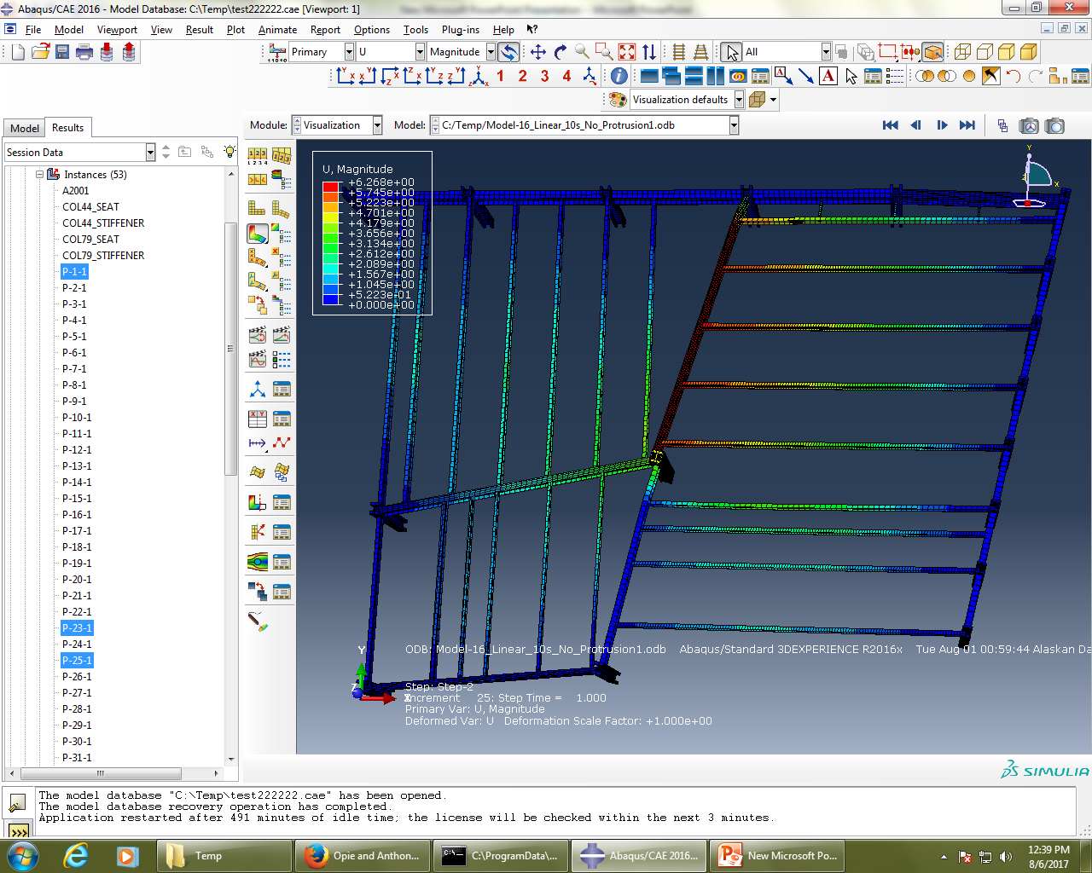

Slide 35
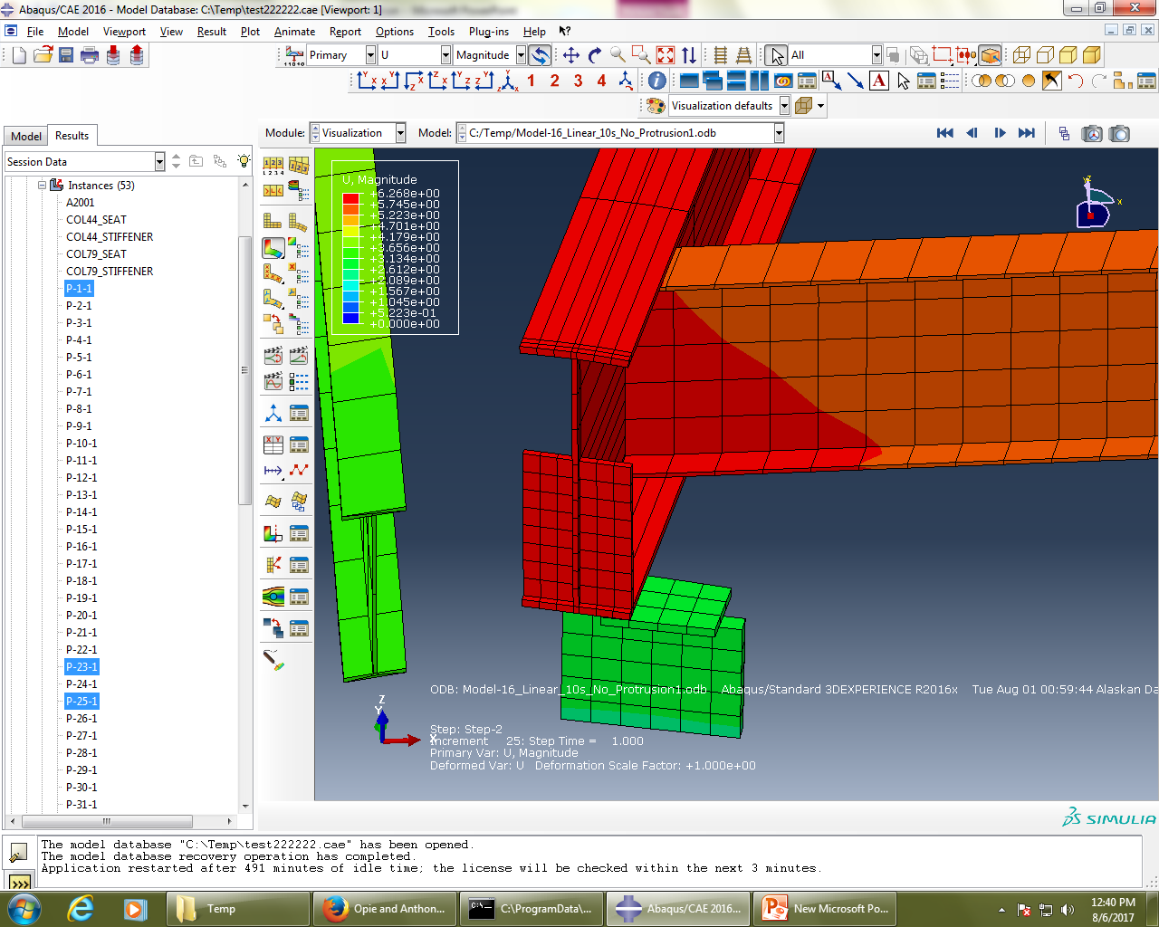

Slide 36
Different Buckling Shapes
The next several diagrams show several buckling shapes of WTC7 prior collapsing.

Slide 37
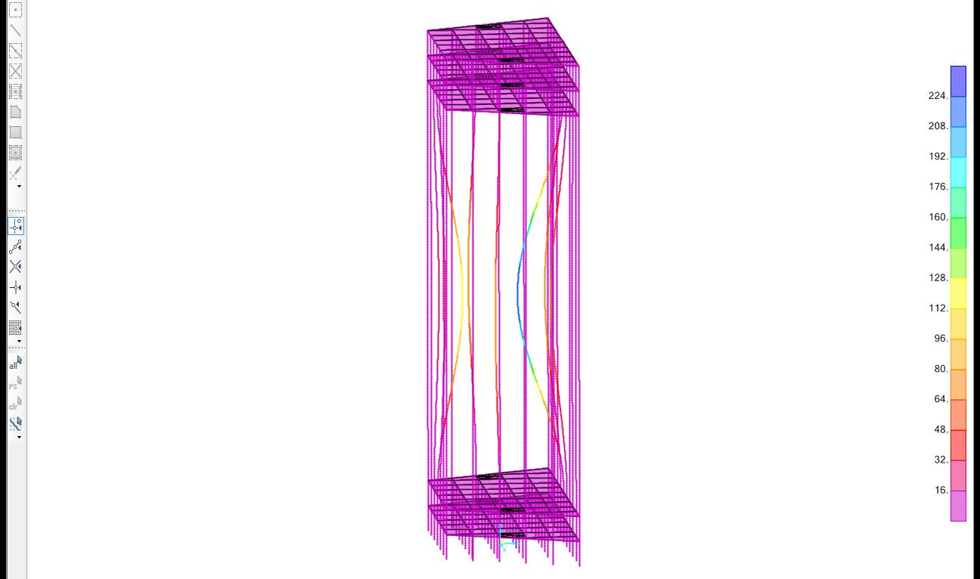

Slide 38
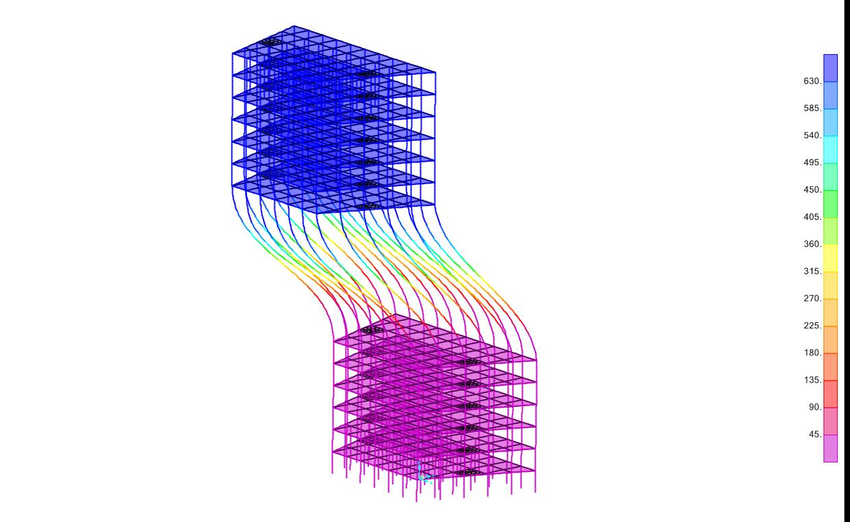

Slide 39
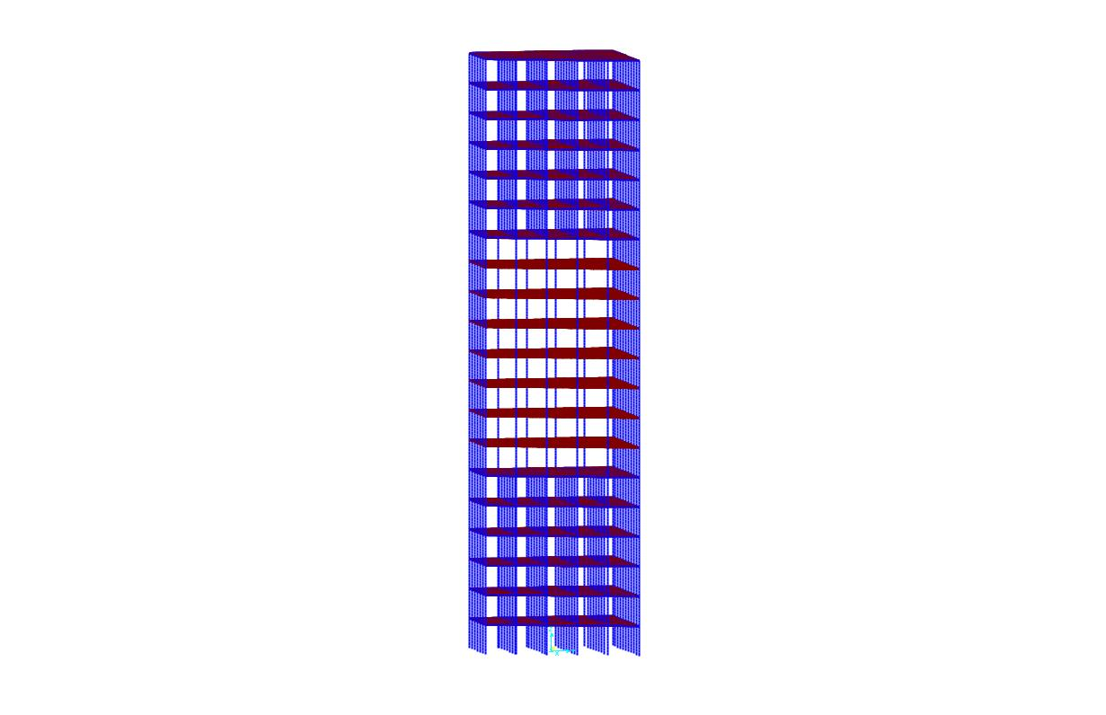

Slide 40
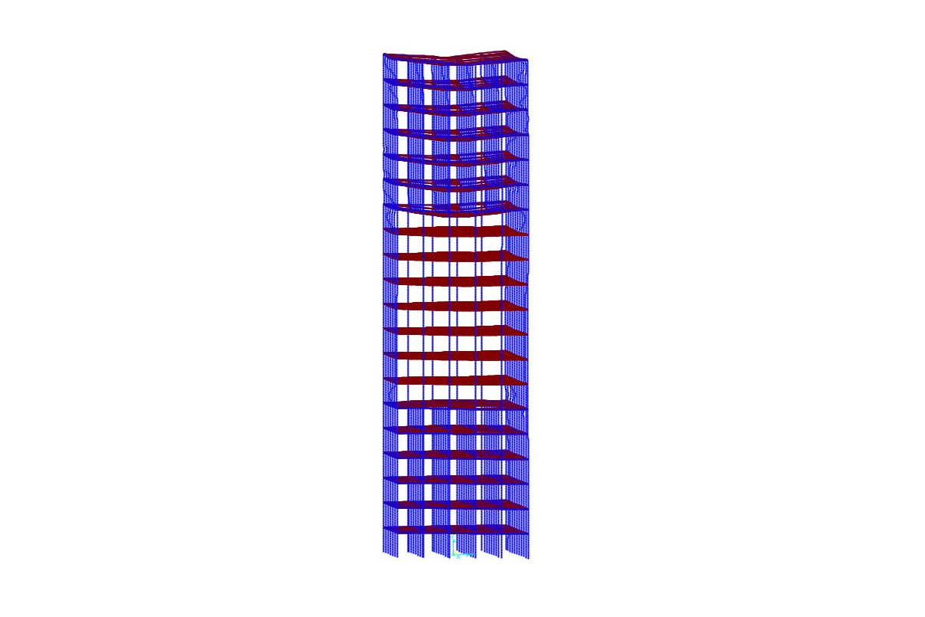

Slide 41
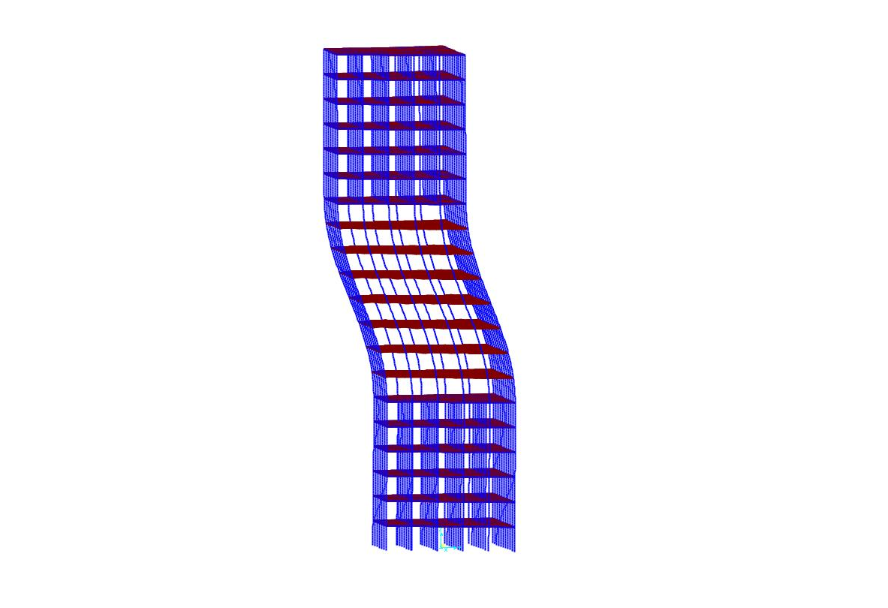

Slide 42
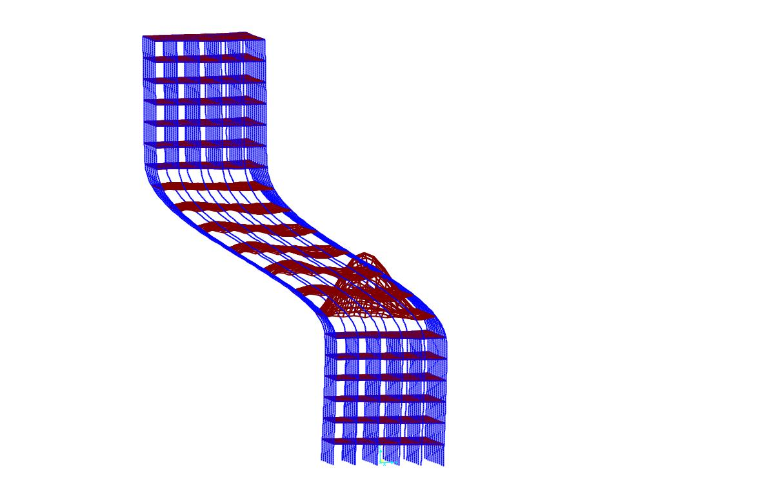

Slide 43
Reference
[1]. https://en.wikipedia.org/wiki/7_World_Trade_Center
[2]. NIST NCSTAR 1-9, “ Structural Fire Response and Probable Collapse Sequence of World Trade Center Building 7”, NIST
[3]. https://www.youtube.com/watch?v=8T2_nedORjw

